Slide 1
Employee salary prediction using Machine learning 💼
CAPSTONE PROJECT
Presented By:
Somanjan Chakraborty
Kalyani Government Engineering College
Electronics and Communication Engineering
STU67eab36e301ee1743434606

Slide 2
OUTLINE
Problem Statement (Should not include solution)
System Development Approach (Technology Used)
Algorithm & Deployment (Step by Step Procedure)
Result
Conclusion
Future Scope(Optonal)
References

Slide 3
Problem Statement
Accurate salary prediction is crucial for fair compensation and organizational planning. Manual methods often lead to bias and employee dissatisfaction. This project develops a machine learning model to objectively predict salaries. It leverages data to ensure equitable pay. The goal is a data-driven approach for informed compensation decisions and a satisfied workforce.

Slide 4
System Approach
Processor: AMD Ryzen 3 2200U with Radeon Vega Mobile Gfx 2.50 GHz
Installed memory (RAM): 12.0 GB (10.9 GB usable)
System type: 64-bit Operating System, x64-based processor

Slide 5
Core Libraries: Python libraries like Pandas for data manipulation, NumPy for numerical operations, and Scikit-learn for machine learning (e.g., RandomForestClassifier, data preprocessing modules).
Serialization: Joblib is used for saving and loading the trained model pipeline.

Slide 6
Algorithm & Deployment
Step 1: Project Setup & Data Acquisition
Set up your Python environment and install necessary libraries (e.g., Pandas, NumPy, Scikit-learn).
Load the adult 3.CSV dataset into your project for analysis.
Step 2: Exploratory Data Analysis (EDA)
Understand the dataset's structure, data types, and identify missing values.
Analyze feature distributions and relationships to gain insights into the data.

Slide 7
Step 3: Data Preprocessing & Feature Engineering
Address missing values using appropriate imputation techniques.
Transform categorical variables into numerical formats (e.g., One-Hot Encoding).
Scale numerical features to ensure consistent influence on the model.
Split the processed data into training and testing sets.
Step 4: Model Selection & Training
Choose a suitable classification algorithm, such as the Random Forest Classifier.
Train your selected model on the prepared training data.
(Optional but recommended) Fine-tune model hyperparameters to optimize performance.

Slide 8
Step 5: Model Evaluation
Assess the trained model's performance using the test set.
Calculate key metrics like accuracy, precision, recall, and F1-score to validate its effectiveness.
Step 6: Model Saving & Deployment
Save the complete machine learning pipeline (including preprocessing and the trained model) using joblib.
Develop a method to load the saved model for future predictions on new data.
Consider creating a simple interface to demonstrate the model’s predictive capability.

Slide 9
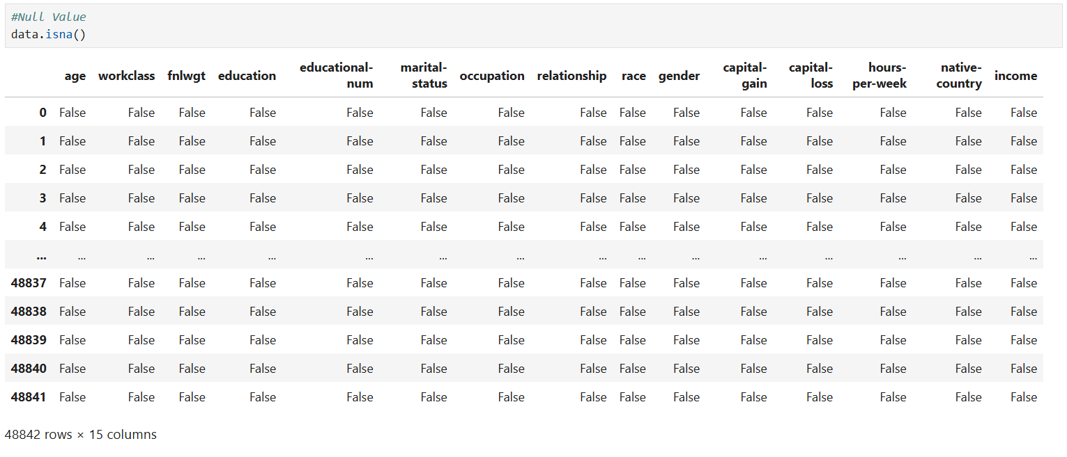
Result
Checking Null value for data cleaning

Slide 10
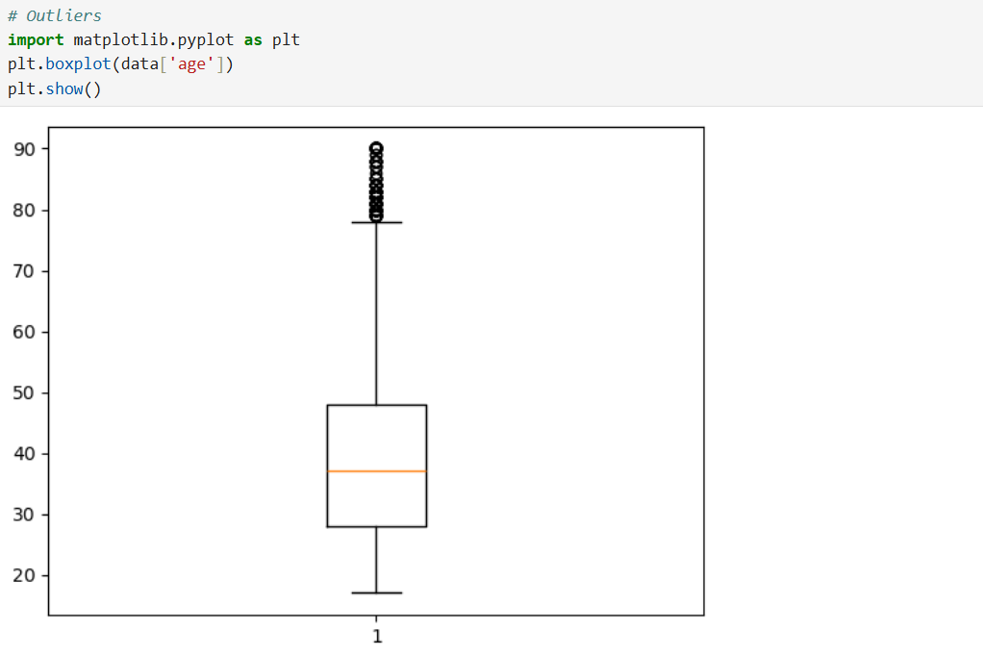
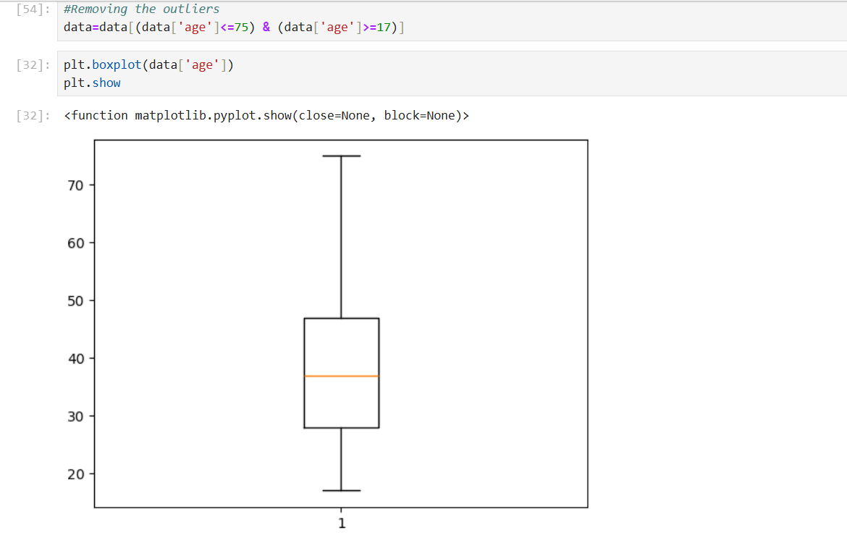
Removing Outliers
With Outliers
Without Outliers

Slide 11
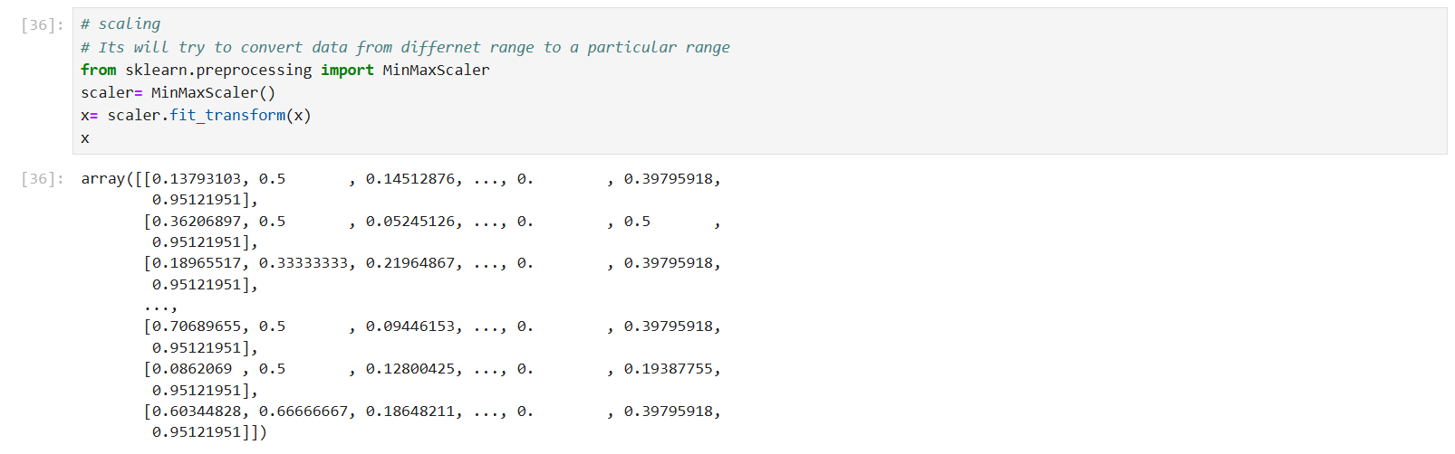
Scaling

Slide 12
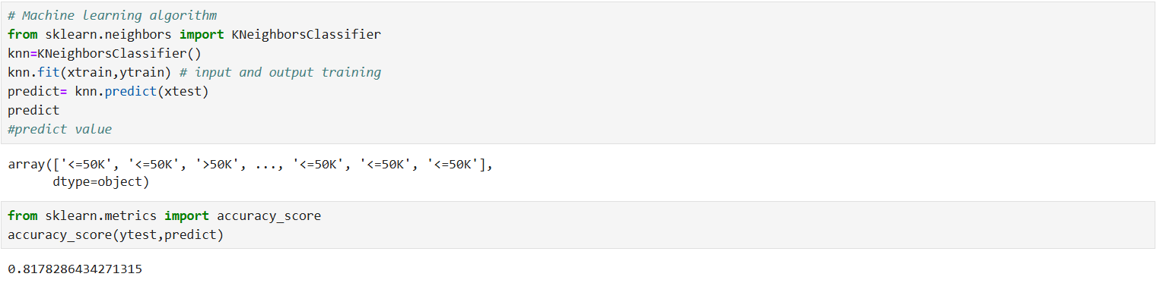
Machine learning algorithm kneighborsclassifier

Slide 13
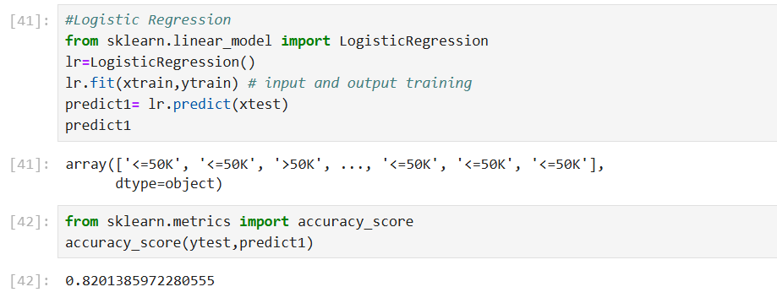
Logistic Regression

Slide 14
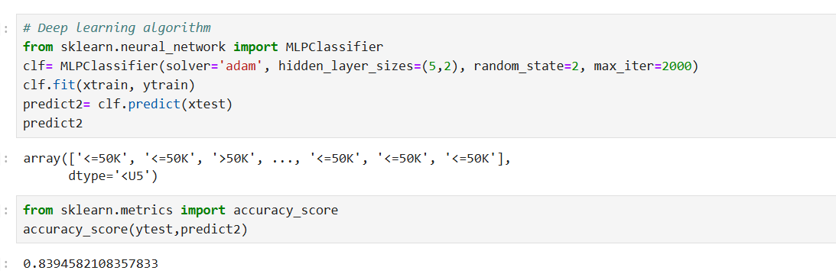
Deep Learning Algorithm

Slide 15
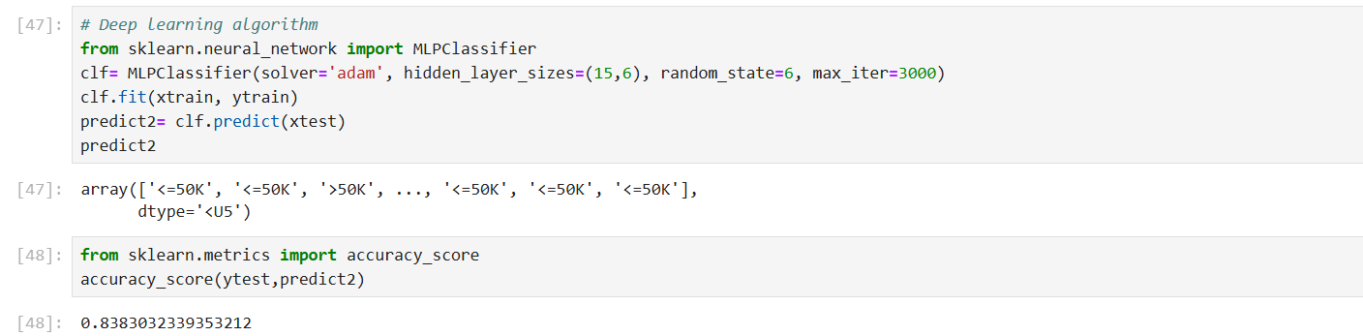
Multi-layer perceptron classifier

Slide 16
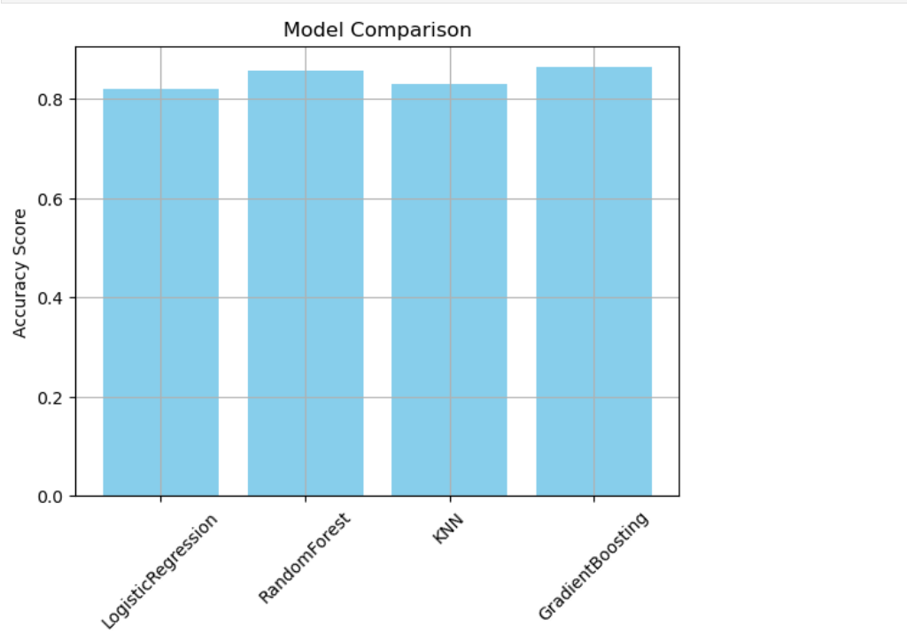
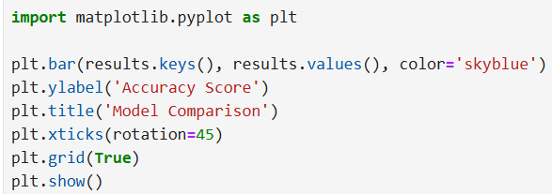
Model Comparison

Slide 17
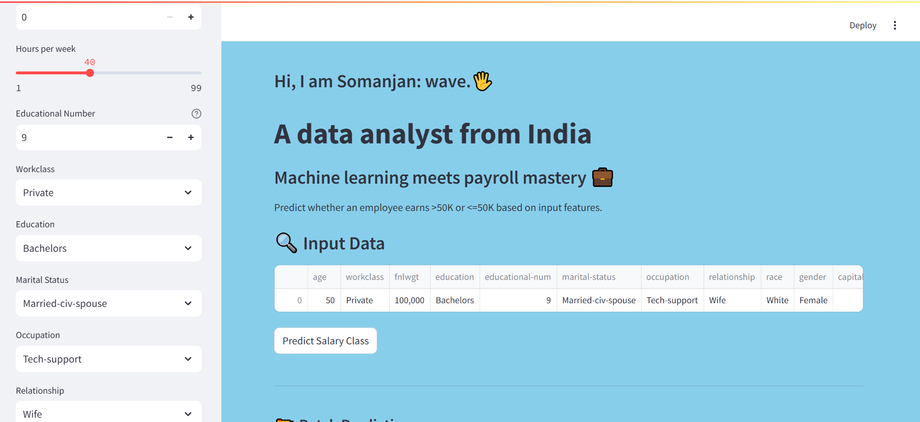
Web App Building In Streamlit

Slide 18
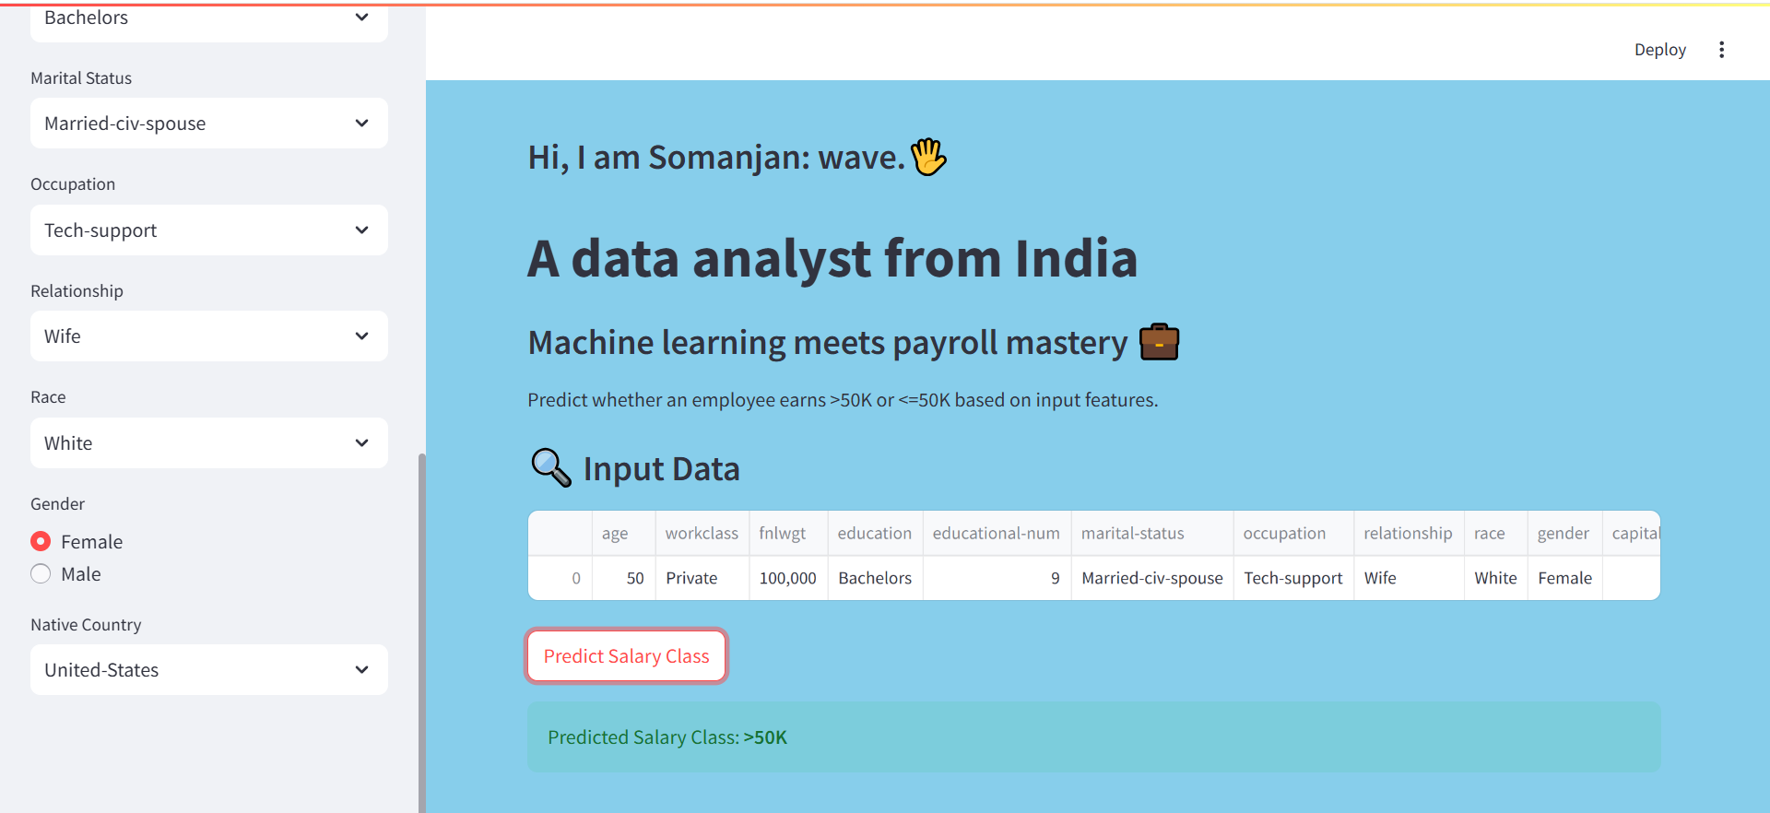

Slide 19
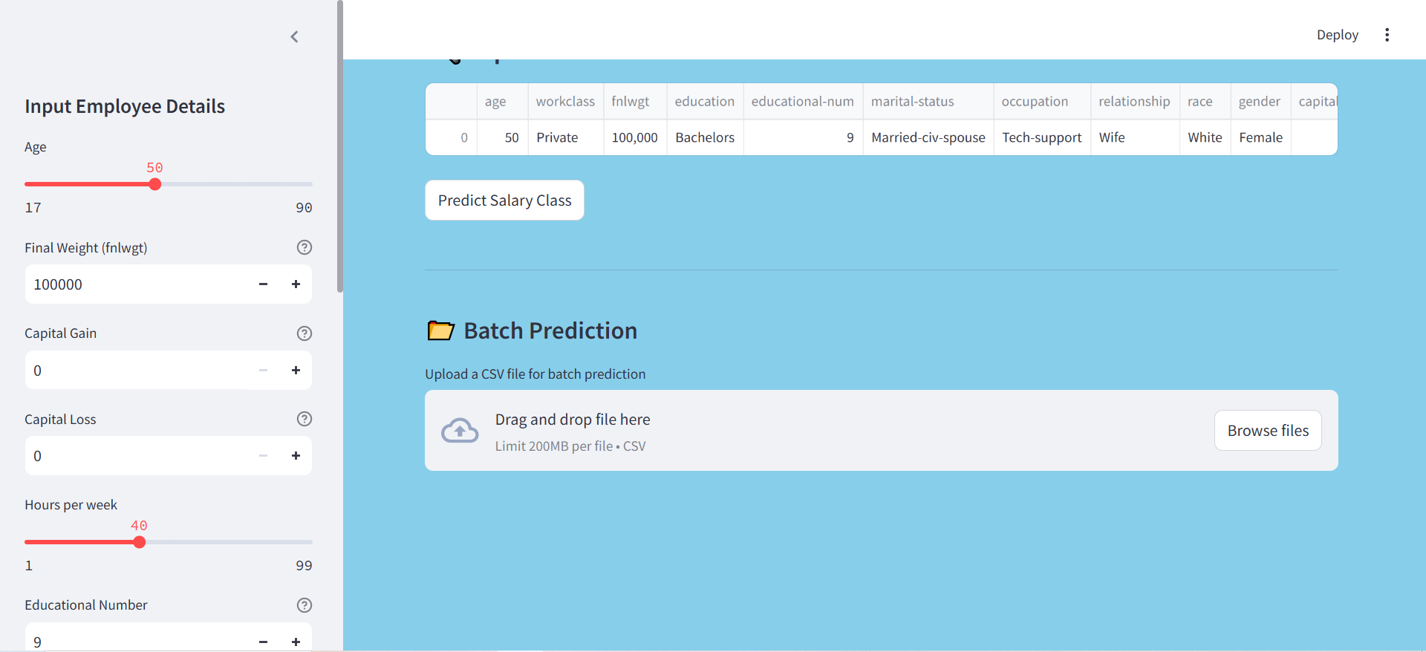

Slide 20
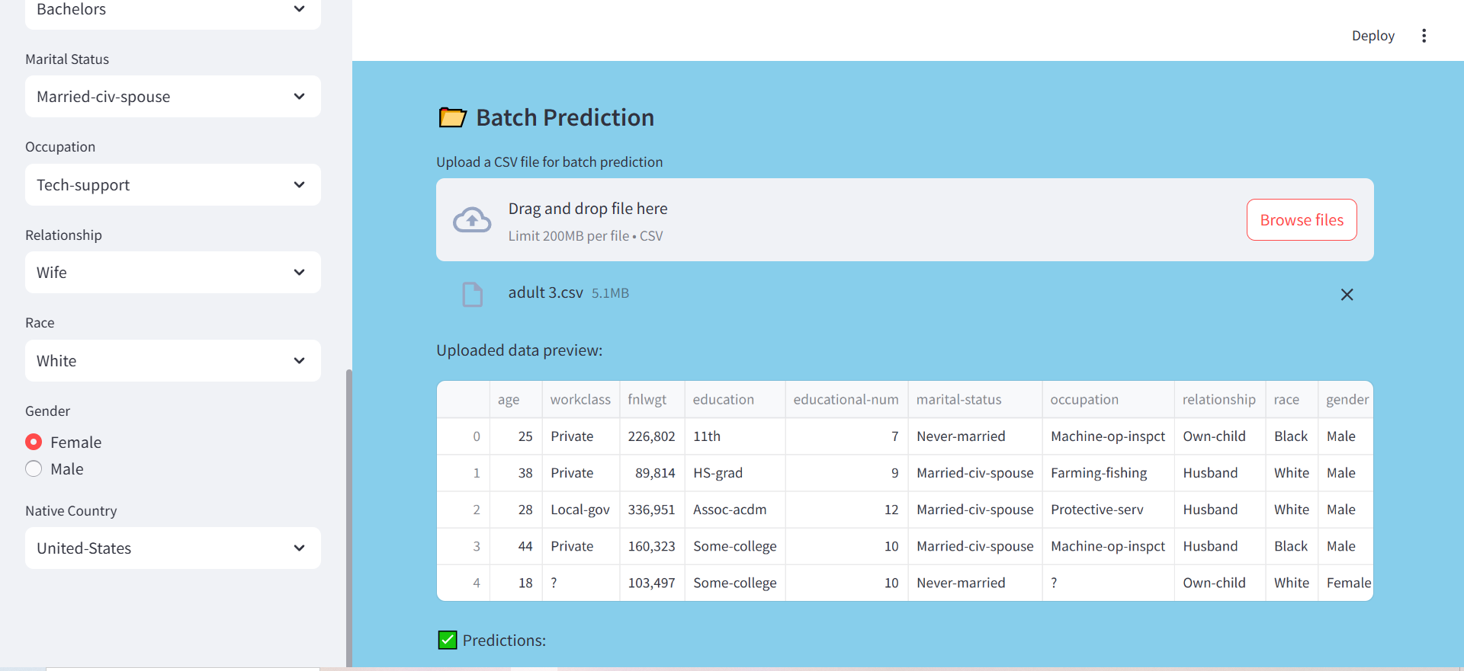

Slide 21
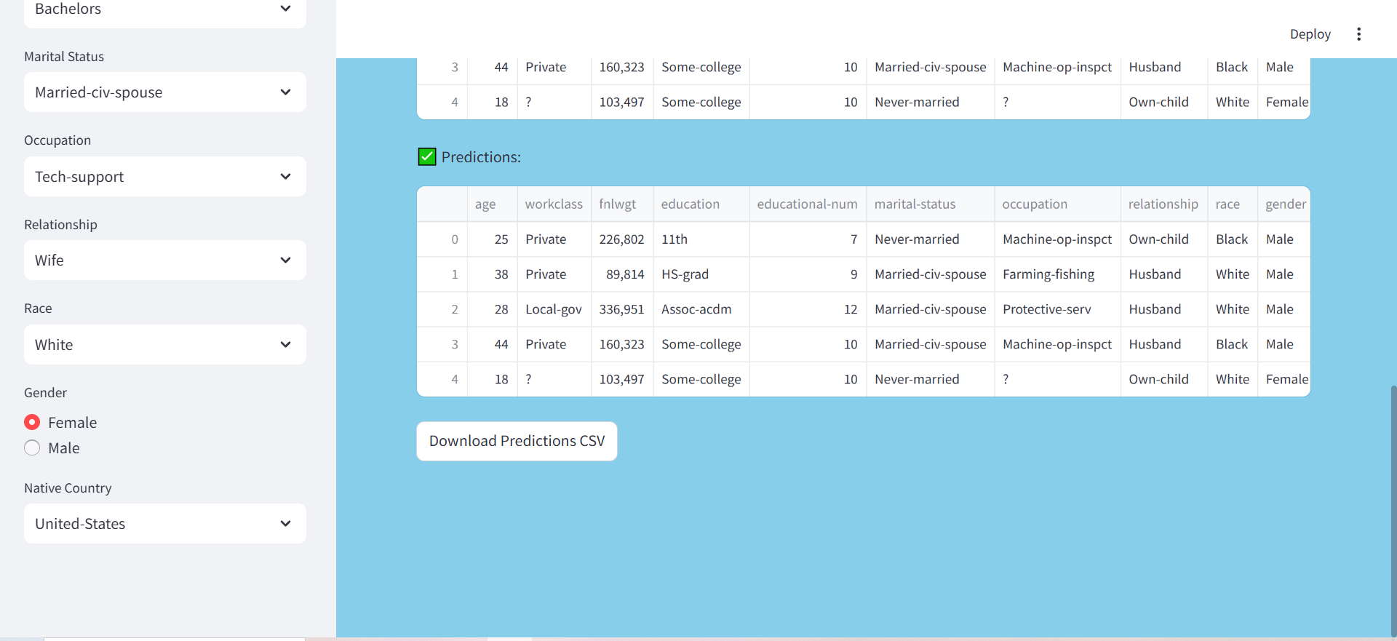

Slide 22
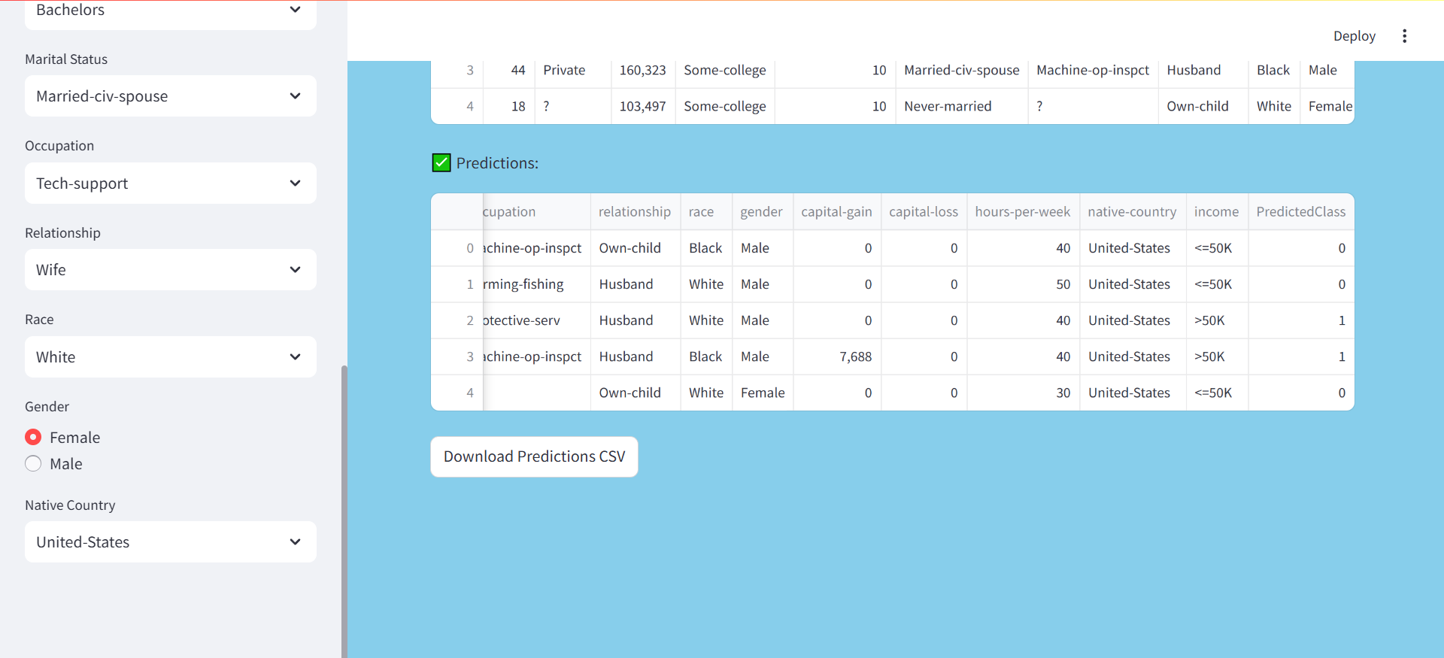

Slide 23
Github link
https://github.com/somanjan056/Machine-learning-meets-payroll-mastery-.git

Slide 24
Conclusion
This project successfully developed a robust machine learning model for employee salary prediction, addressing the complexity of fair compensation.
By leveraging the Random Forest Classifier and comprehensive data preprocessing, the model achieved a high level of accuracy in predicting salary brackets.
The system provides a data-driven and objective tool for organizations, minimizing bias and promoting equitable pay practices.
This predictive capability can significantly aid in informed decision-making for recruitment, budgeting, and employee retention strategies.
Ultimately, the project demonstrates the power of machine learning in fostering a more transparent and fair compensation framework within an organization.

Slide 25
Future scope(Optional)
Explore Advanced Algorithms: Investigate and implement more sophisticated machine learning models like Gradient Boosting Machines (e.g., XGBoost, LightGBM) or neural networks for potentially higher accuracy.
Integrate Additional Data Sources: Incorporate external datasets such as industry salary benchmarks, economic indicators, or detailed employee performance reviews to enrich the model's predictive capabilities.
Bias Detection and Mitigation: Implement techniques to identify and reduce potential biases within the predictions, ensuring fairness and equity across all demographic groups.
Develop a User-Friendly Application: Create a web-based application or API that allows HR professionals to input employee data and receive instant salary predictions, enhancing usability.
Continuous Learning & Monitoring: Establish a system for regular model retraining with new data and continuous monitoring of its performance to ensure long-term accuracy and relevance.
Explainable AI (XAI): Focus on making the model's predictions more interpretable, providing insights into why a particular salary is predicted, aiding in trust and transparency.

Slide 26
References
Original Dataset Source:
Dua, D. and Graff, C. (2017). UCI Machine Learning Repository [http://archive.ics.uci.edu/ml]. Irvine, CA: University of California, School of Information and Computer Science.
Specifically for the Adult Dataset: Kohavi, R. (1996). "Scaling Up the Accuracy of Naive-Bayes Classifiers: a Decision-Tree Hybrid." Proceedings of the Second International Conference on Knowledge Discovery and Data Mining. AAAI Press.

Slide 27
Programming Language & Libraries:
Python Official Documentation: https://docs.python.org/
Pandas Documentation: The pandas Development Team. (2020). pandas-dev/pandas: Pandas. https://pandas.pydata.org/docs/
NumPy Documentation: Harris, C. R., et al. (2020). "Array programming with NumPy." Nature, 585(7825), 357-362. https://numpy.org/doc/
Scikit-learn Documentation: Pedregosa, F., et al. (2011). "Scikit-learn: Machine Learning in Python." Journal of Machine Learning Research, 12, 2825-2830. https://scikit-learn.org/stable/documentation.html

Slide 28
Machine Learning Concepts & Algorithms:
Random Forest: Breiman, L. (2001). "Random Forests." Machine Learning, 45(1), 5-32.
General ML Textbooks: Hastie, T., Tibshirani, R., & Friedman, J. (2009).
The Elements of Statistical Learning: Data Mining, Inference, and Prediction. Springer.

Slide 29
THANK YOU

